Slide 1
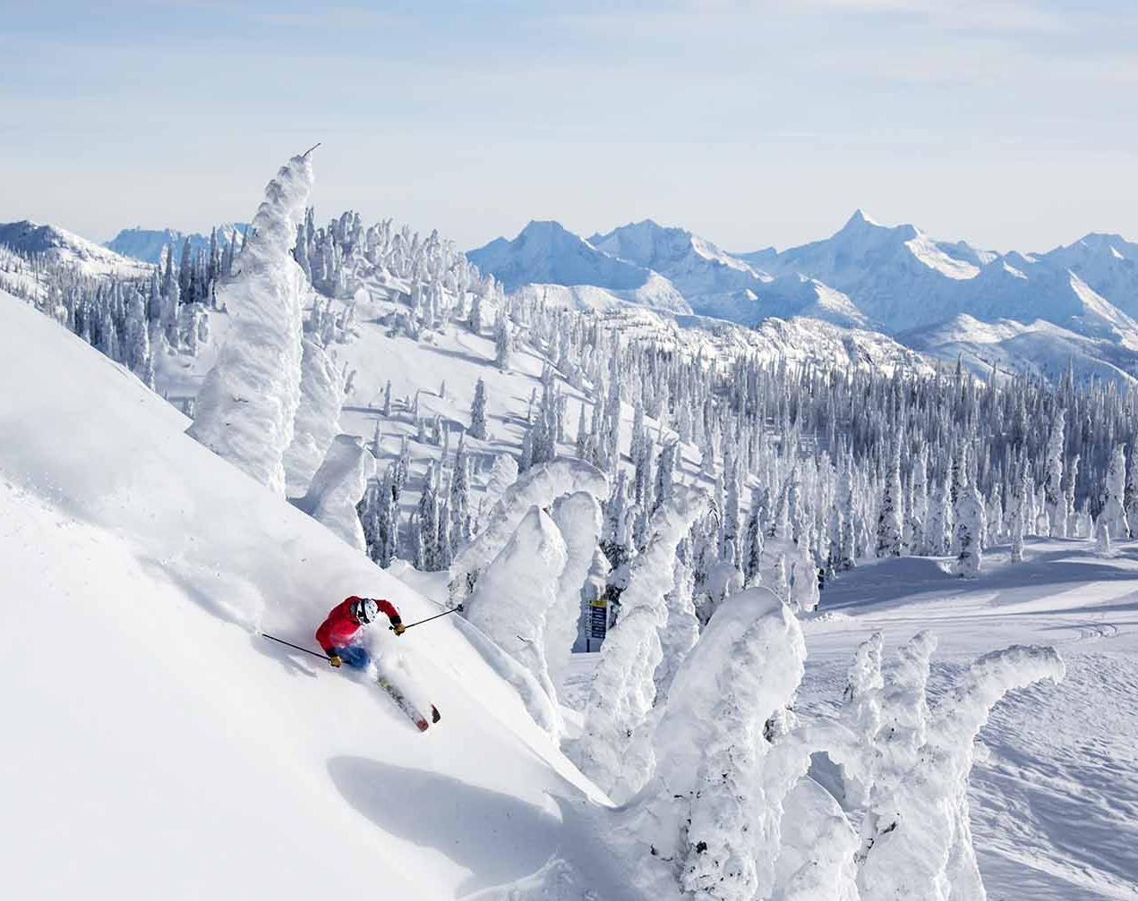
Big Mountain Resort
Ticket Price Evaluation:
Maria Meza

Slide 2

Problem Identification and Recommendation
Problem:
Need to select an adequate ticket value for Big Mountain Resort in order to increase revenue to at least cover the costs of the $1,540,000 newly implemented ski lift before the end of the year/ season.
Recommendations:
A: Raise the ticket price to 95.39. and remove one run to cut on costs.
B: Add one run, a chair lift, and increase the vertical drop

Slide 3
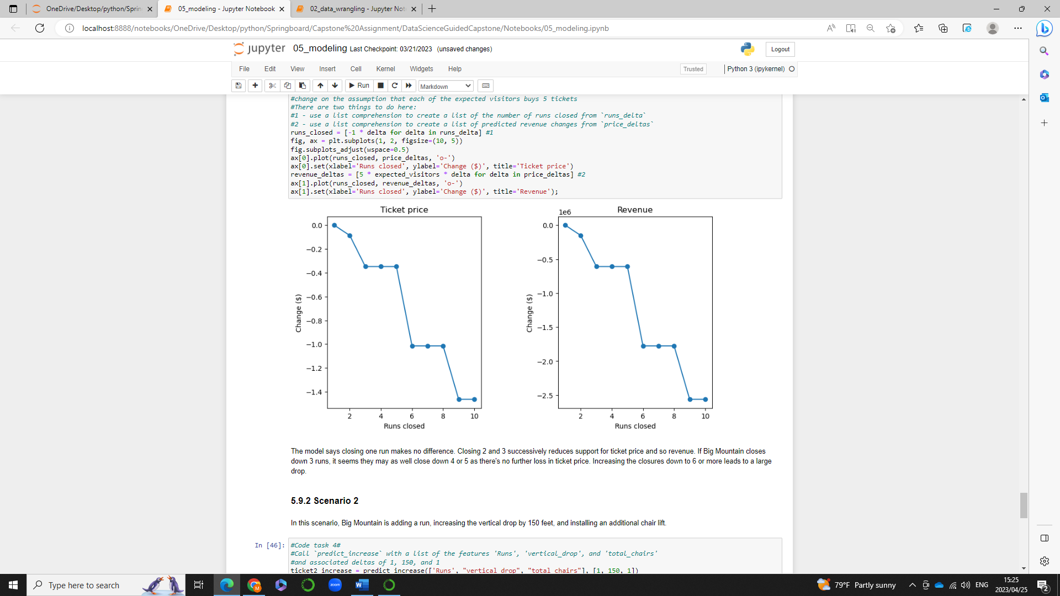
Recommendation and Key Findings: A
Solution A : Raise
The modeled price that seems to be supported by the marketplace, is $95.39 USD.
Removing one run will not affect the cost of Big Mountain Ski resort ticket price.
** Removing 2 or more runs will affect the ticket price**

Slide 4
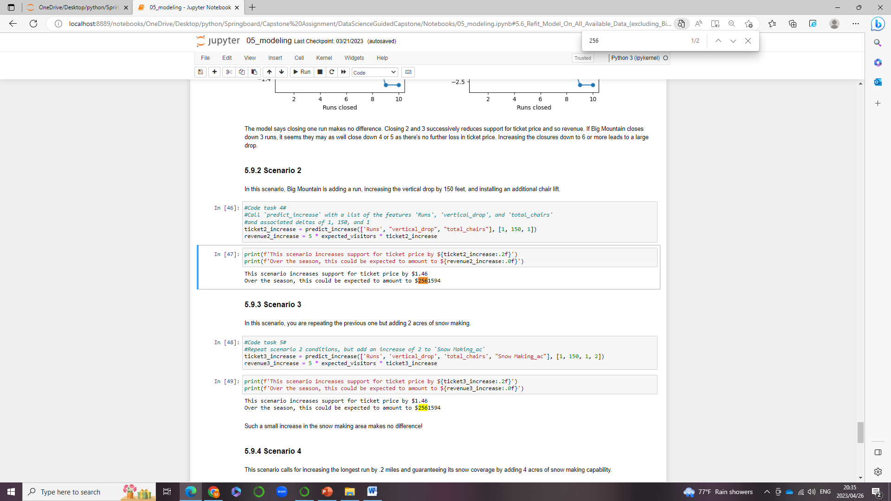

Solution B: Increasing the drop to 150 feet and installing one additional chair lift allows for an increase in ticket price by $1.46. In one season it amounts to be to $2,561,594.
Recommendation and Key Findings: B

Slide 5

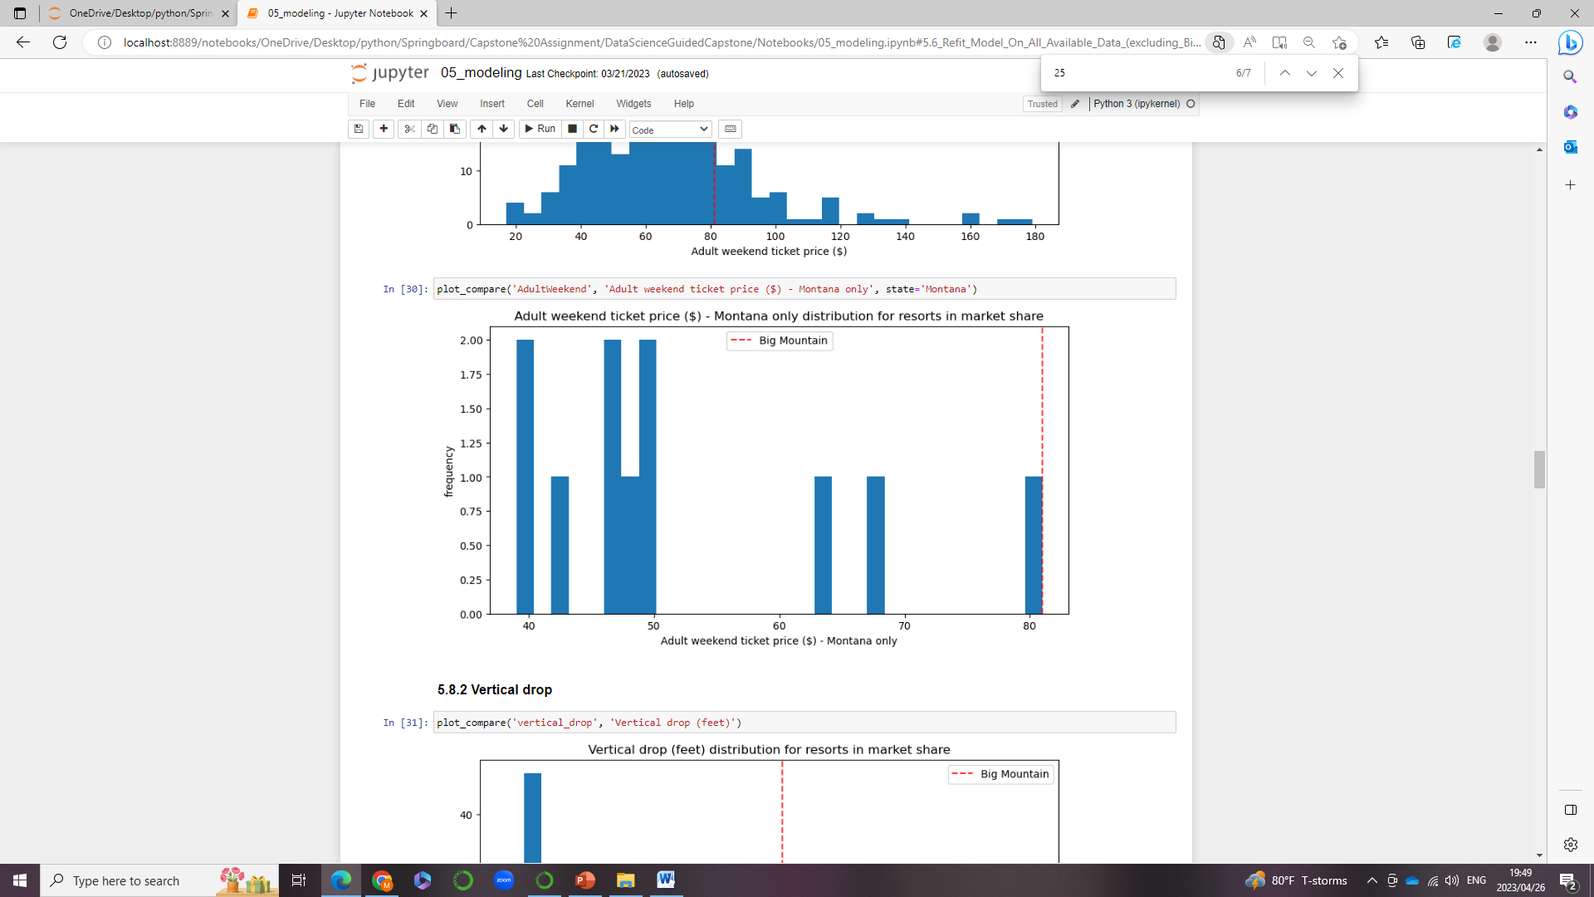
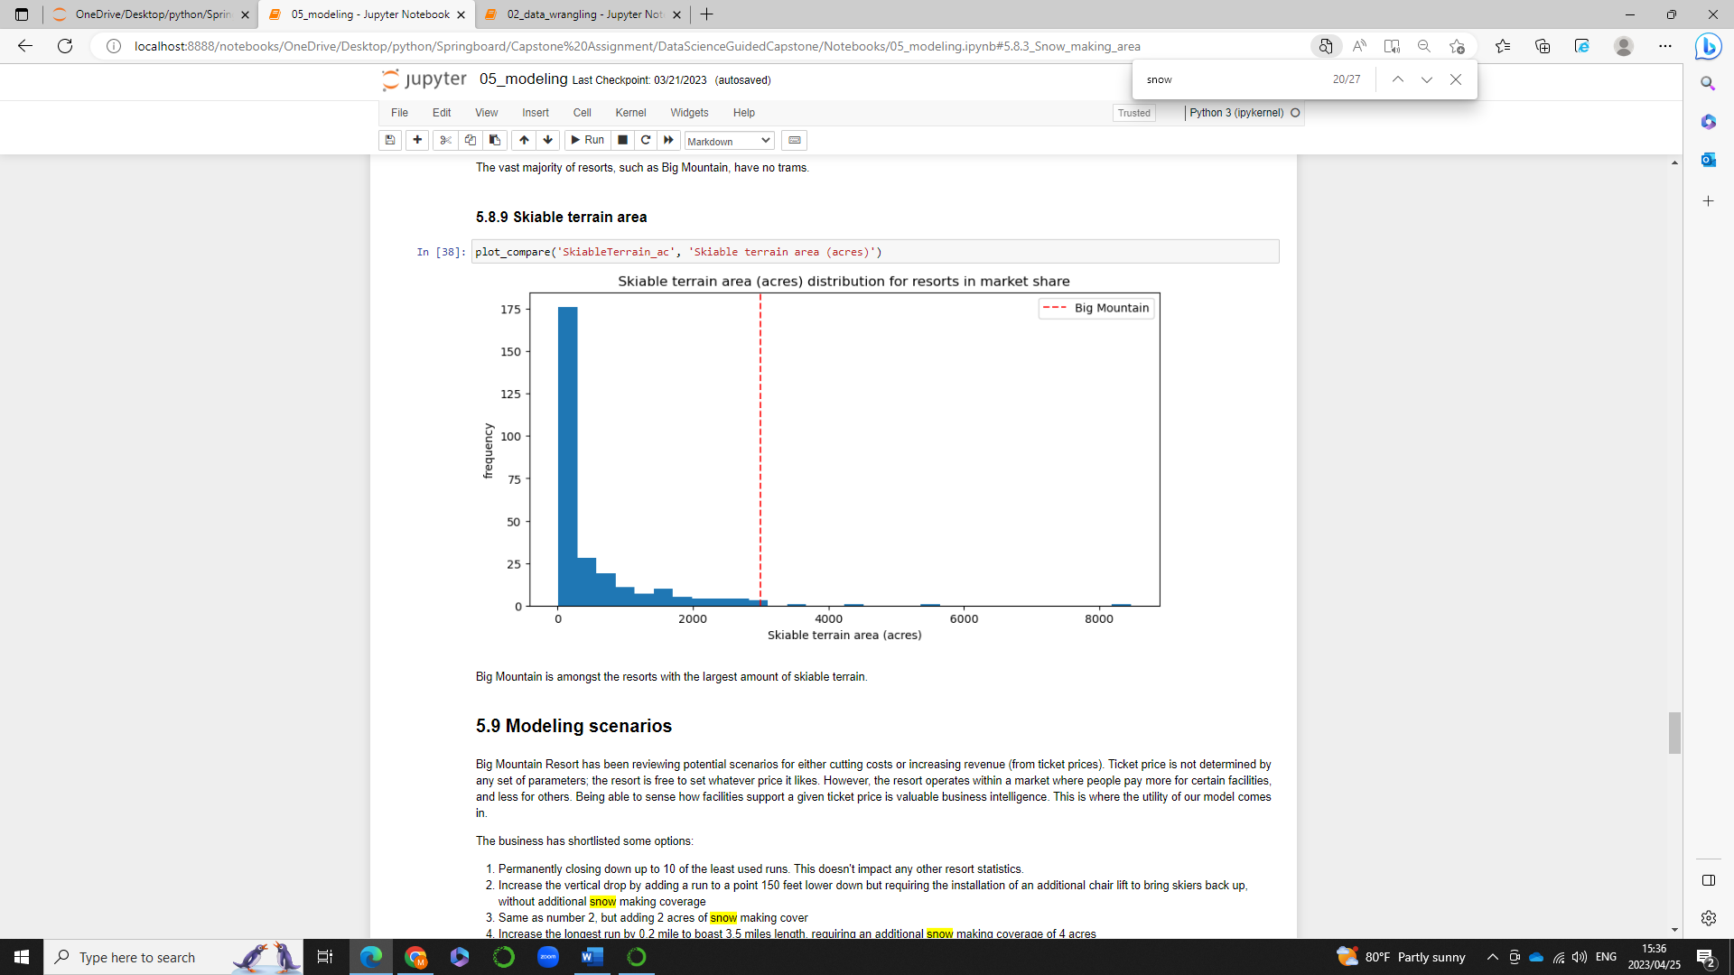
Modeling results and analysis 1: Big Mountain Ski Resort is on the Higher End
It may not be as obvious but, Big Mountain resort is on the higher end of the spectrum.
Big Mountain Resort may have the highest price, but also has the most skiable terrain, and also has fast Quads available
Big Mountain resort ticket price is undervalued at $80 USD. It should be Valued at around $95.39 USD

Slide 6
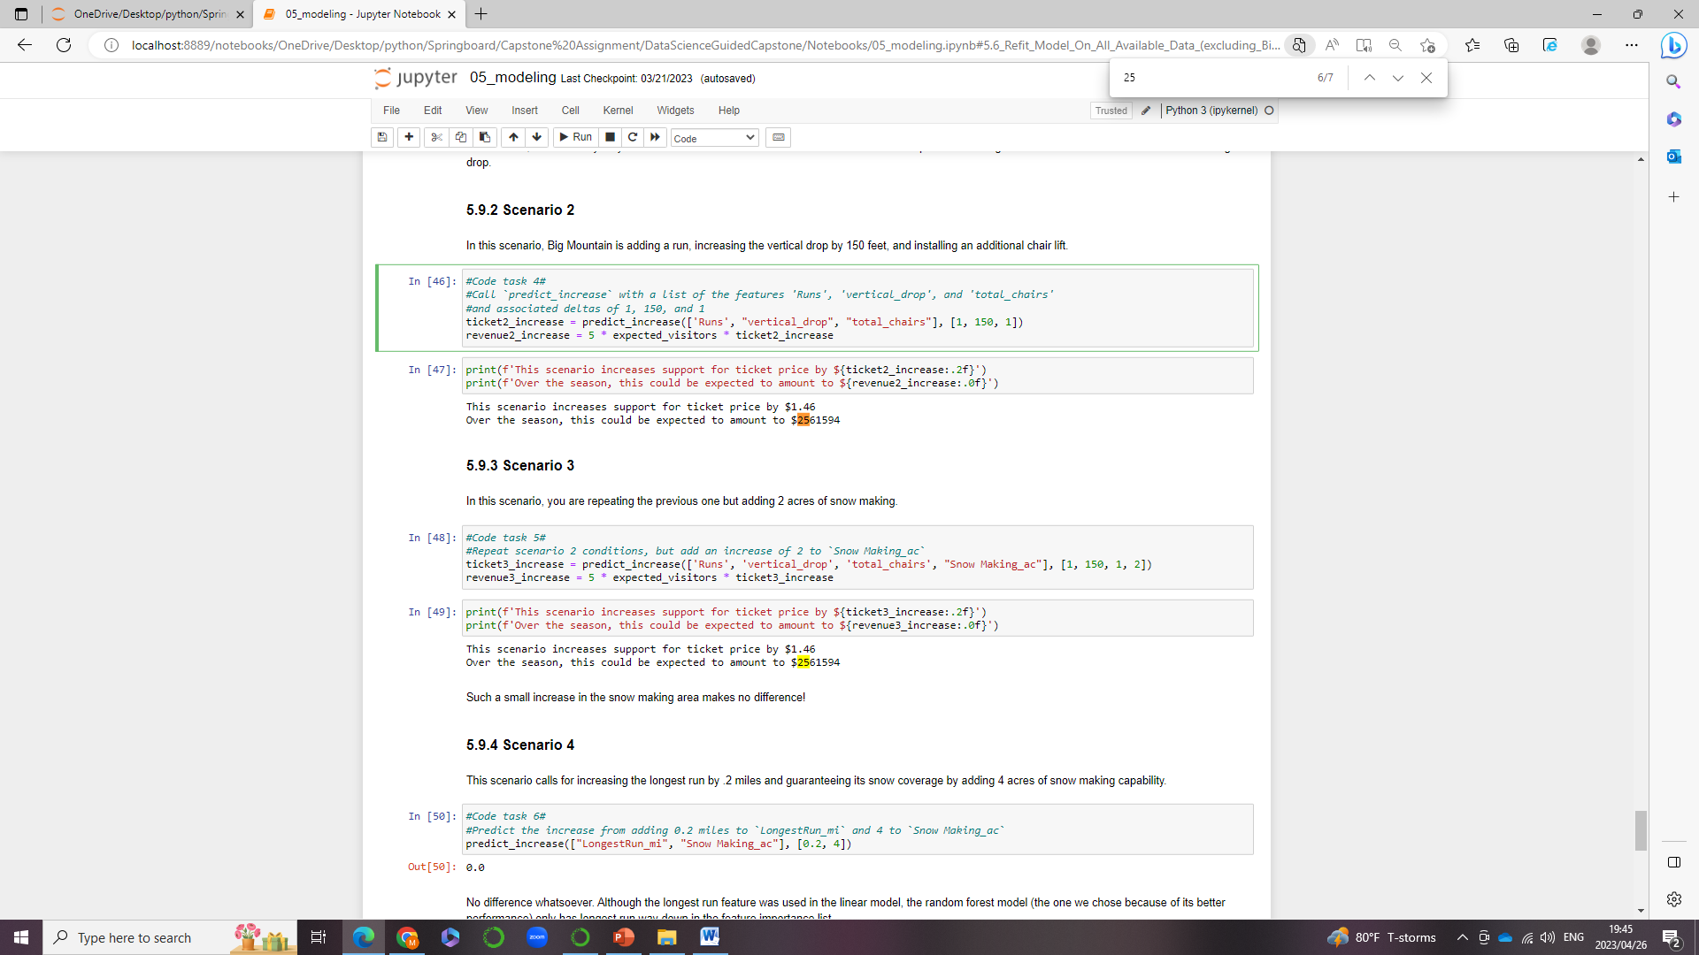
Modeling results and analysis 2
Variables that were significant in determining ticket price
Vertical drop
Increase vertical drop by150 ft -> Yes change
Snow Making
Increase by adding 4 acres of snow -> No effect
Total chairs
Adding a chair lift -> Yes change
Fast Quads
Already has 3 when majority of resorts have none
Runs
*Add a run -> yes change
Longest Run (mi)
Increase by .2 mi -> No effect
Trams
N/A ( majority of resorts have none)
Skiable Terrain
N/A (Already has most skiable terrain)
** All these changes must be implemented together for there to be a ticket price increase of $1.46 USD

Slide 7

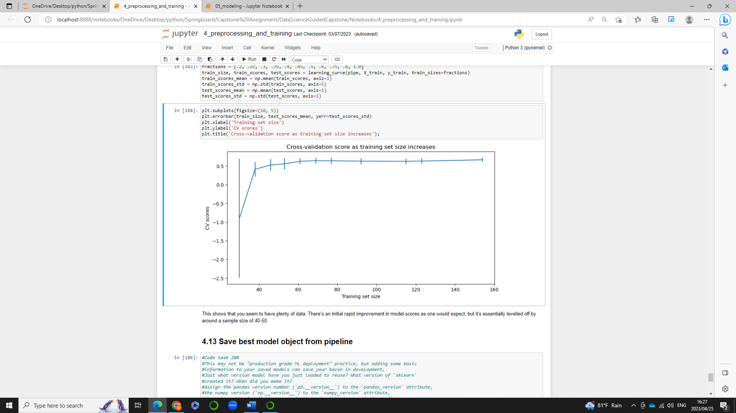
Modeling results and analysis 3
Cross validation balances out at a training set size of 40, thus there is enough data.
No more data needs to be collected

Slide 8
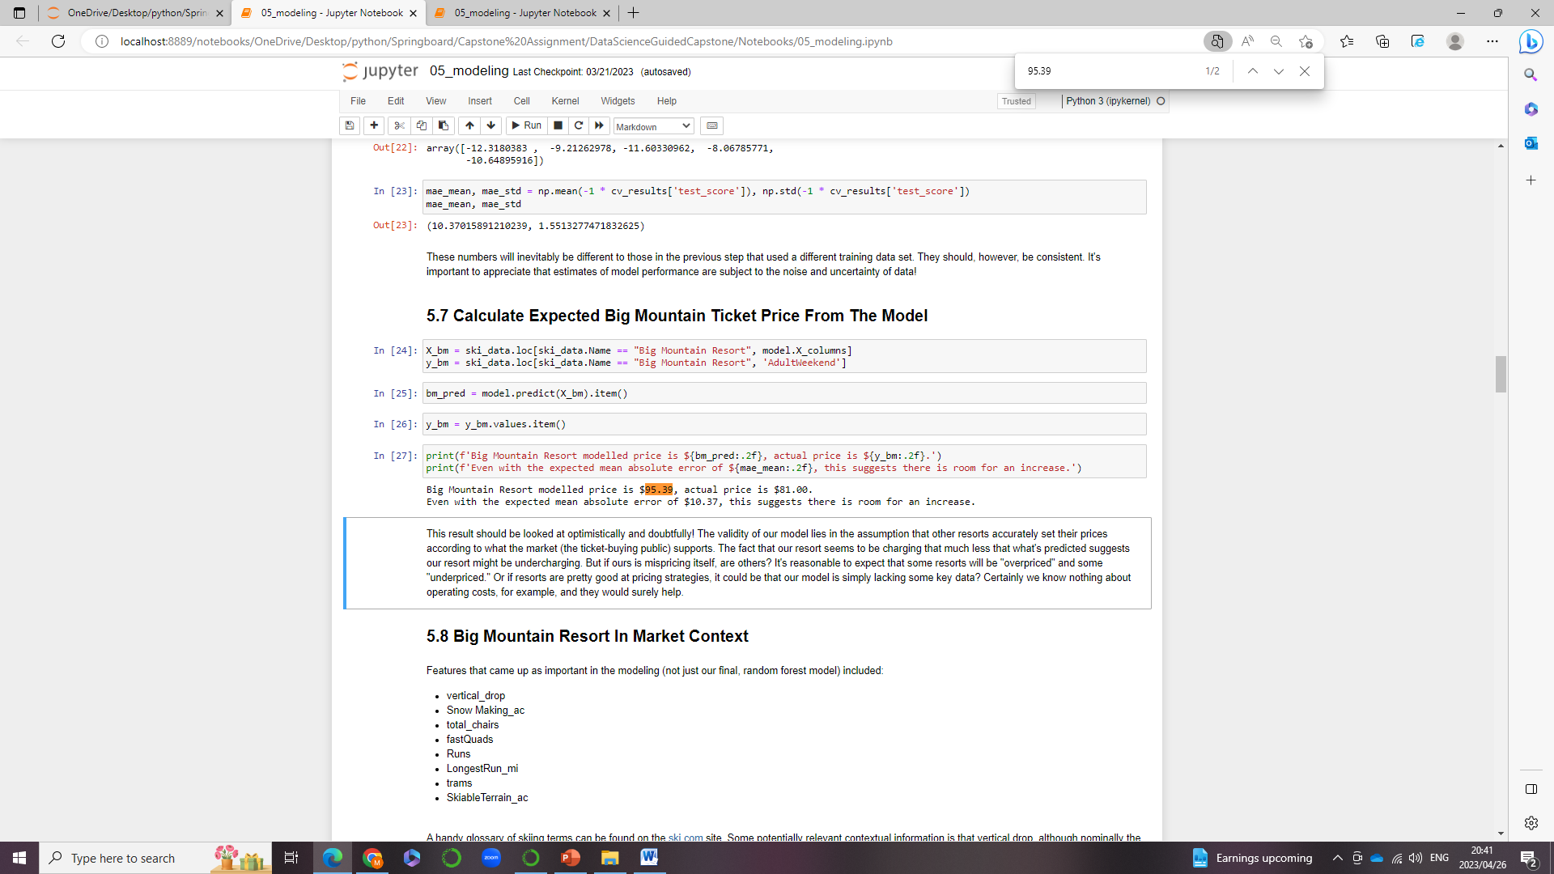
Summary and Conclusion
There are multiple opportunities to increase the ticket price
Implementing the new chair lift will cost $1,540,000, however if a run is added, and the vertical drop Is increased by 150 ft as well as to adding the lift, the ticket price can be increased even further by $1.46, which can amount to $2,561,594 in one season, greatly surpassing the $1,540,000 cost.

